Slide 1
Android Activity Lifecycle

Slide 2
android.app.Activity
subclass of ContextThemeWrapper class.
7 lifecycle methods of android activity.
MethodDescription
onCreate called when activity is first created.
onStart called when activity is becoming visible to the user.
onResume called when activity will start interacting with the user.
onPause called when activity is not visible to the user.
onStop called when activity is no longer visible to the user.
onRestart called after your activity is stopped, prior to start.
onDestroy called before the activity is destroyed.

Slide 3
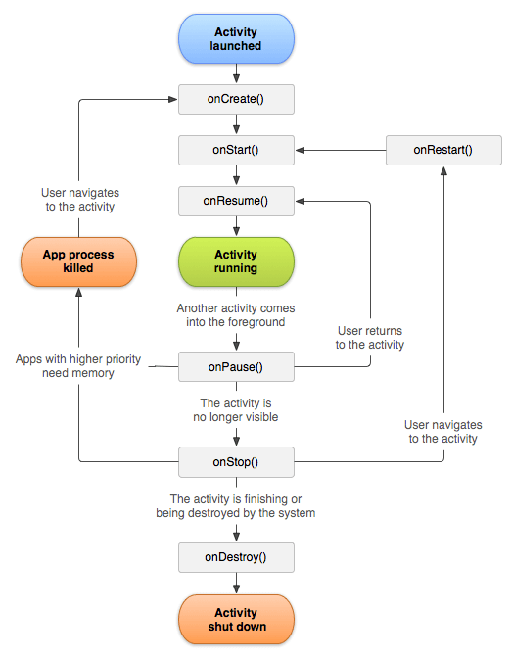

Slide 4
<android.support.constraint.ConstraintLayout xmlns:android="http://schemas.android.com/apk/res/android"
xmlns:app="http://schemas.android.com/apk/res-auto"
xmlns:tools="http://schemas.android.com/tools"
android:layout_width="match_parent"
android:layout_height="match_parent"
tools:context="example.javatpoint.com.activitylifecycle.MainActivity">
<TextView
android:layout_width="wrap_content"
android:layout_height="wrap_content"
android:text="Hello World!"
app:layout_constraintBottom_toBottomOf="parent"
app:layout_constraintLeft_toLeftOf="parent"
app:layout_constraintRight_toRightOf="parent"
app:layout_constraintTop_toTopOf="parent" />
</android.support.constraint.ConstraintLayout>

Slide 5
Android Fragments
Android Fragment is the part of activity
sub-activity
Fragments represent multiple screen inside one activity
The FragmentManager class is responsible to make interaction between fragment objects.

Slide 6
Android Fragment Lifecycle Methods
1)onAttach(Activity)
2)onCreate(Bundle)
3)onCreateView
4)onActivityCreated(Bundle)
5)onViewStateRestored(Bundle)
6)onStart()
7)onResume()
8)onPause()
9)onStop()
10)onDestroyView()
11)onDestroy()
12)onDetach()

